Slide 1

Loftium – Project Overview
Problem Statement
Loftium seeks to maximize Airbnb revenue from private rooms
Desired Outcome
A predictive model that best estimates recurring Airbnb revenue for private rooms

Slide 2
Loftium – Project Overview
Project Scope
Explore Loftium data
Evaluate Loftium’s existing model
Scrape for additional data
Develop alternative predictive models

Slide 3
Exploring the Data
Laying out assumptions
Phase 1: Limited to Loftium data - Seattle
Target: Expected Monthly Revenue (EMR)
Expected Daily Revenue (EDR)
Project Priority:
Predictive accuracy
Extra feature engineering
Statistical inference

Slide 4
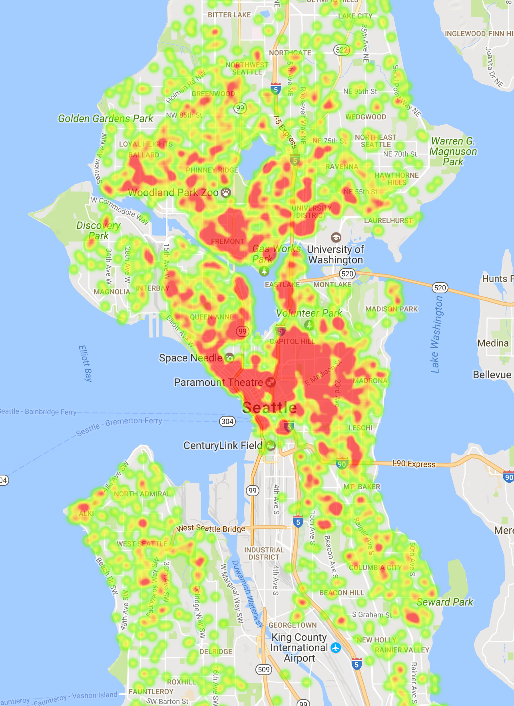
Identifying Hypotheses
EDR is driven by:
Location, location, location!
Majority of predictive power
Seasonality
Host quality
Are there any non-locational, non-seasonal features we can use to improve model accuracy?

Slide 5
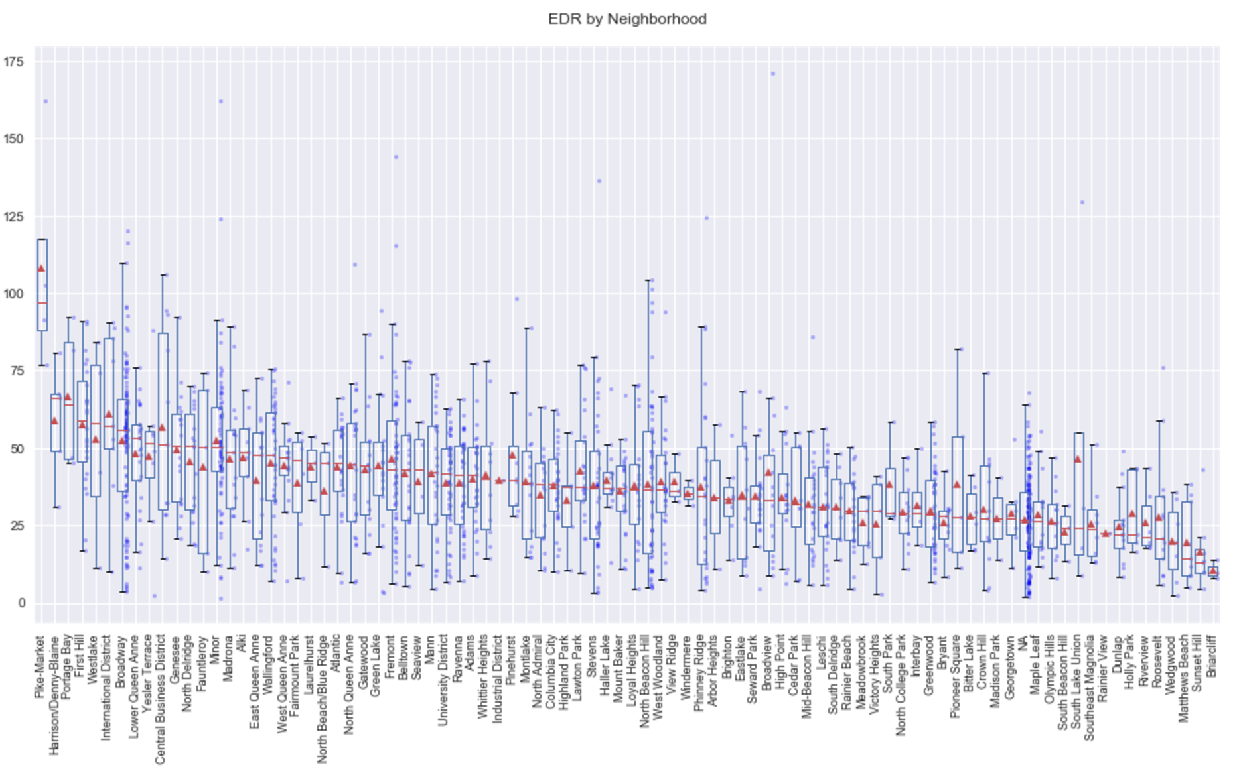
Location, Location, Location!

Slide 6
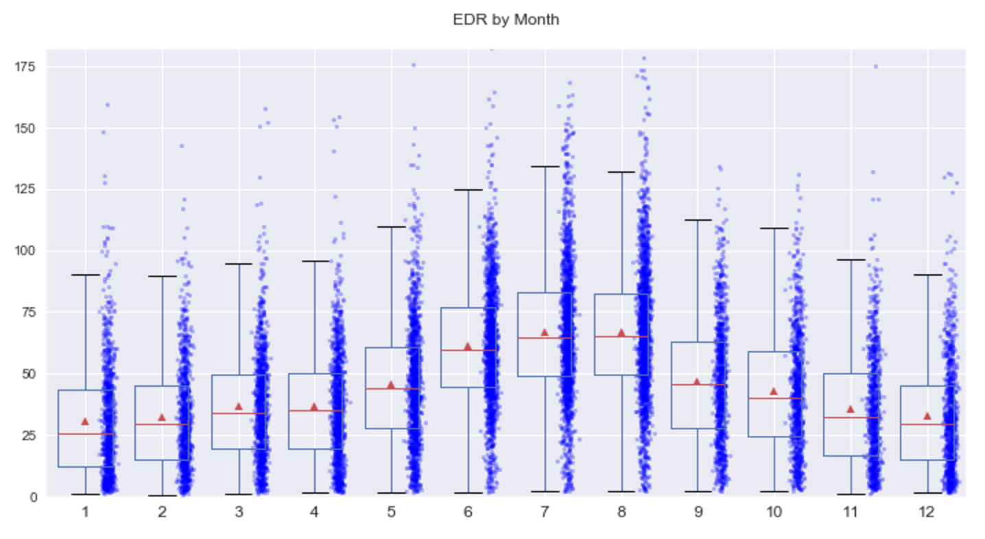
Exploring Seasonality

Slide 7
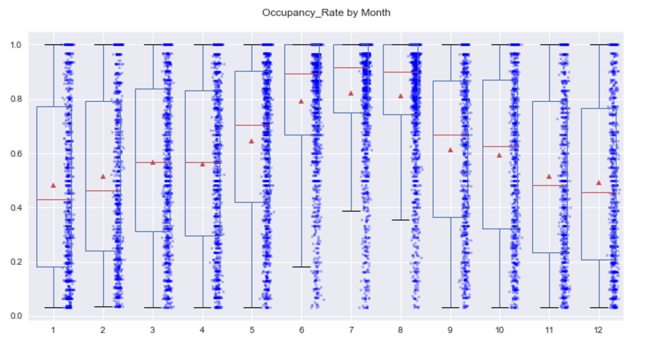
Exploring Seasonality

Slide 8
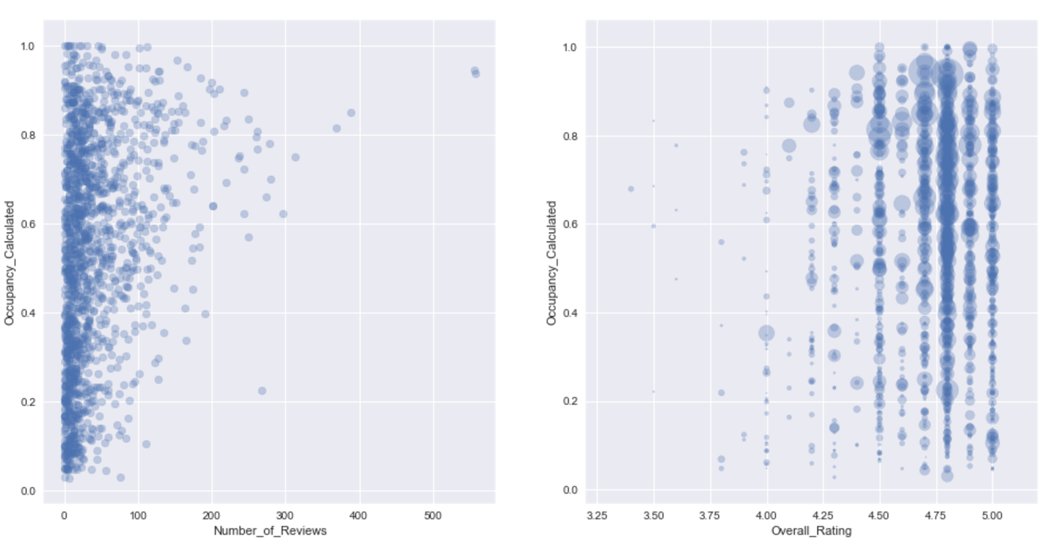
Exploring Host Quality

Slide 9
Loftium – Project Overview
Project Scope
Explore Loftium data
Evaluate Loftium’s existing model
Scrape for additional data
Develop alternative predictive models

Slide 10
Evaluation of Loftium Model
Scoring
Metric = RMSE (Root Mean Squared Error)
Really penalizes bad predictions!
Based on Loftium Model: RMSE = 26.25
Roughly speaking, predicted EDR differs from actual EDR by about $26
This seems bad, but there are a LOT of “outliers” in data
Further segmentation will yield much better results
What specific property types are the “core” for Loftium?

Slide 11
Loftium – Project Overview
Project Scope
Explore Loftium data
Evaluate Loftium’s existing model
Scrape for additional data
Develop alternative predictive models

Slide 12
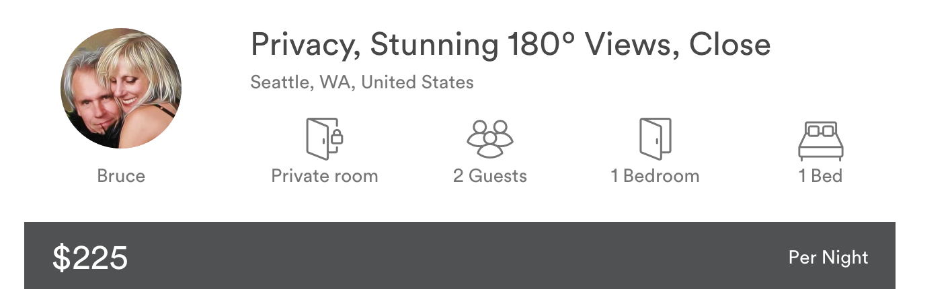
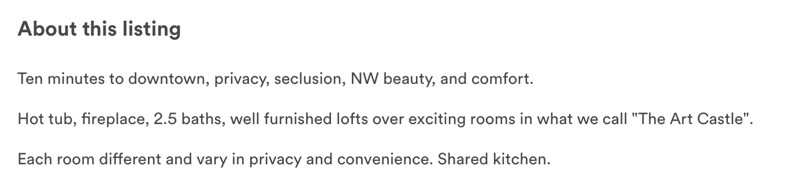
Finding Additional Features
Natural Language Processing

Slide 13
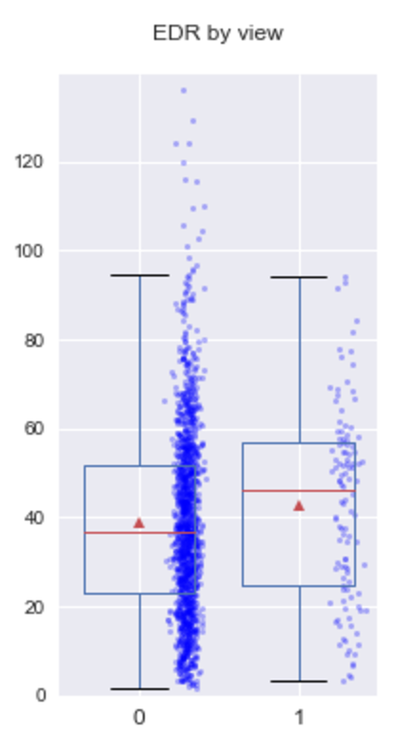
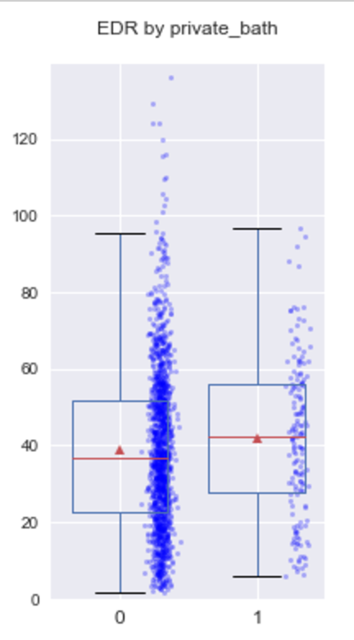
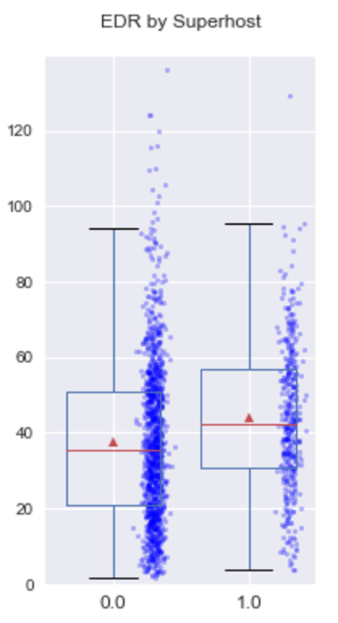
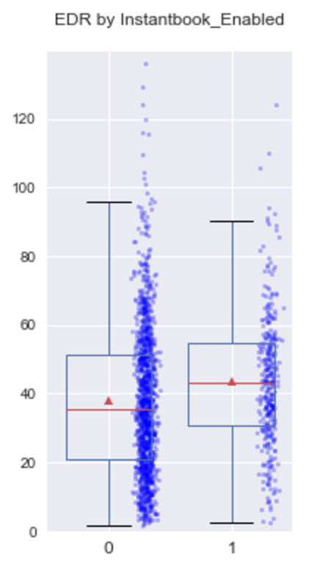
Finding Additional Features

Slide 14
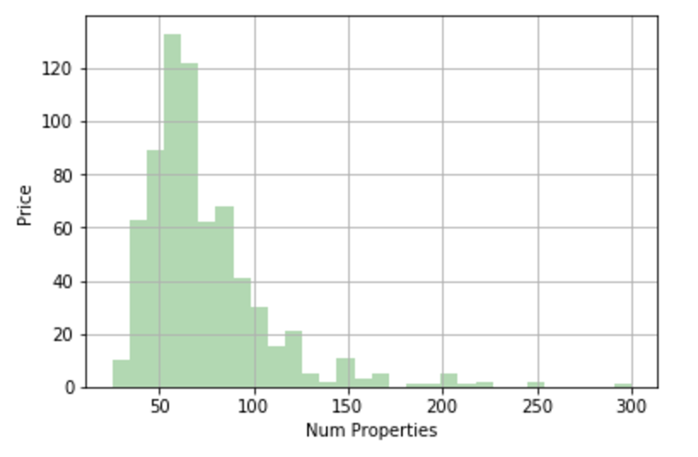
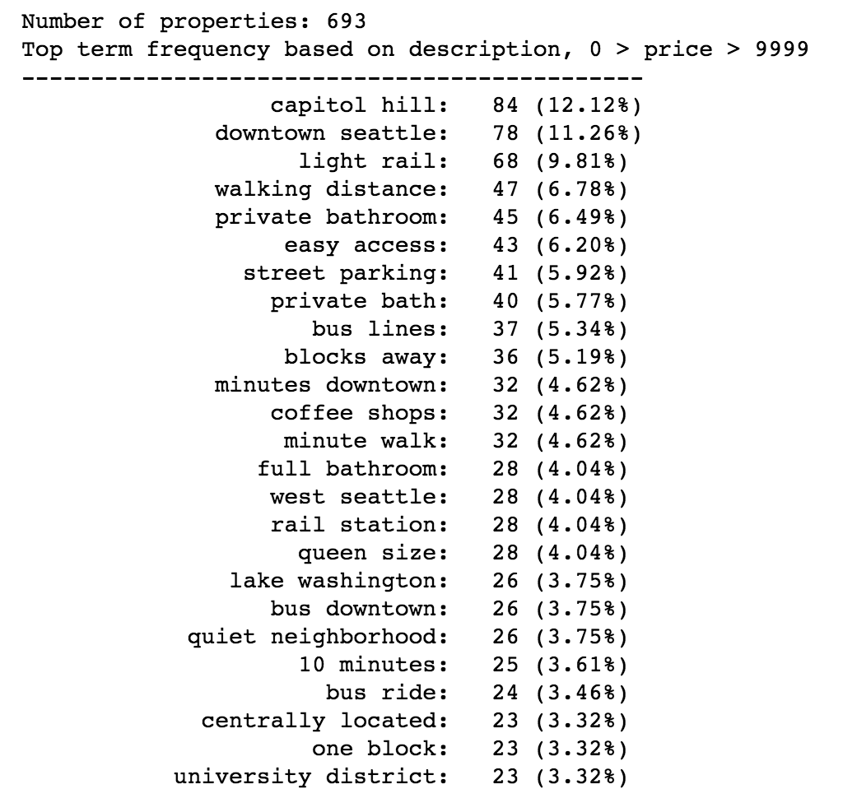
Text Mining

Slide 15
Text Mining
Bigram | Count | %
light rail | 14 | 30.43%
downtown seattle | 8 | 17.39%
rail station | 7 | 15.22%
clean quiet | 6 | 13.04%
university washington | 6 | 13.04%
walk othello | 5 | 10.87%
othello light | 5 | 10.87%
quiet cozy | 5 | 10.87%
quiet jewish | 5 | 10.87%
by bus | 5 | 10.87%
station 8mile | 5 | 10.87%
neighborhood quiet | 5 | 10.87%
walk seward | 5 | 10.87%
community just | 5 | 10.87%
jewish community | 5 | 10.87%
just 1mile | 5 | 10.87%
coffee shops | 5 | 10.87%
seward park | 5 | 10.87%
8mile walk | 5 | 10.87%
1mile walk | 5 | 10.87%
minutes walk | 4 | 8.70%
washer dryer | 4 | 8.70%
easy access | 4 | 8.70%
easy bus | 4 | 8.70%

Slide 16
Text Mining
Bigram | Count | %
private bath | 41 | 6.18%
light rail | 29 | 8.53%
capitol hill | 25 | 7.35%
easy access | 25 | 7.35%
downtown seattle | 24 | 7.06%
blocks away | 22 | 6.47%
walking distance | 20 | 5.88%
bus downtown | 20 | 5.88%
street parking | 19 | 5.59%
coffee shops | 19 | 5.59%
10 minutes | 18 | 5.29%
bus lines | 18 | 5.29%
minute walk | 17 | 5.00%
columbia city | 17 | 5.00%
university district | 16 | 4.71%
west seattle | 16 | 4.71%
minutes downtown | 15 | 4.41%
queen size | 15 | 4.41%
shared kitchen | 14 | 4.12%
quiet neighborhood | 14 | 4.12%
craftsman home | 13 | 3.82%
shops restaurants | 13 | 3.82%
shared bathroom | 13 | 3.82%
15 minutes | 13 | 3.82%

Slide 17
Text Mining

Slide 18
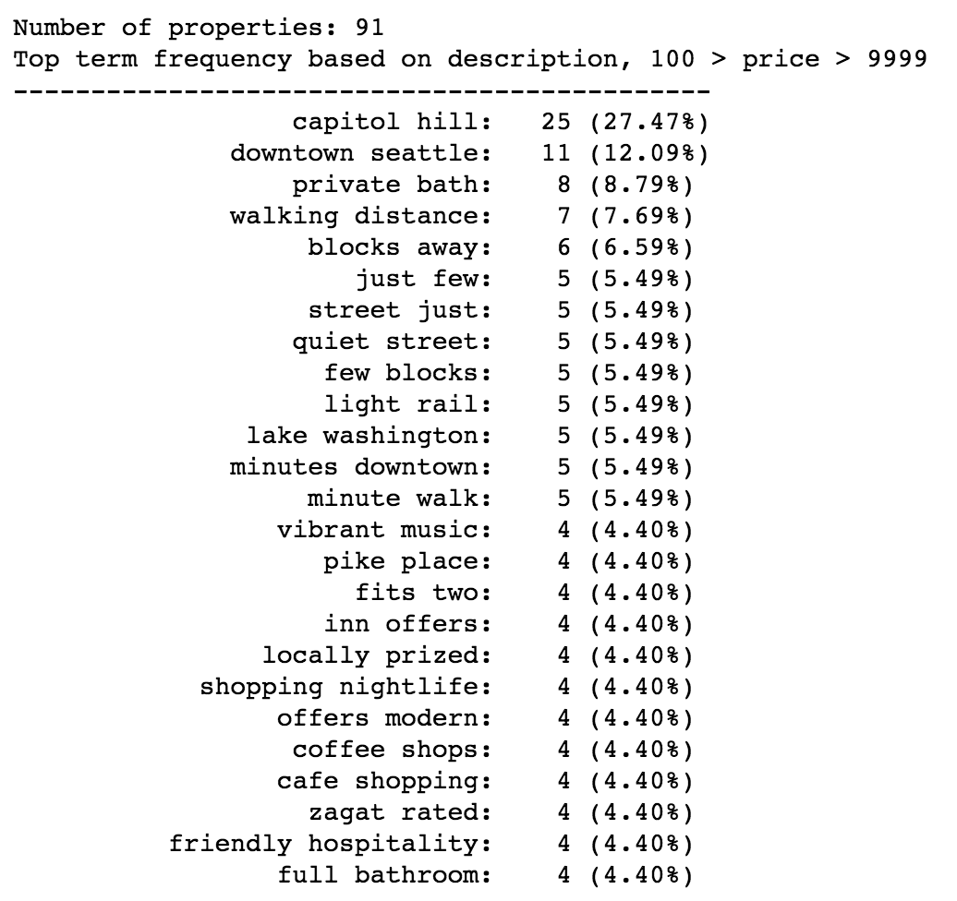
Text Mining

Slide 19
Loftium – Project Overview
Project Scope
Explore Loftium data
Evaluate Loftium’s existing model
Scrape for additional data
Develop alternative predictive models

Slide 20
Loftium – Next Steps
Alternative Questions to Explore:
Customer acquisition predictive model
What customer profiles are most likely to use Loftium’s services?
What property profiles are the best candidates for Loftium’s services?

